Slide 1
ChatBot
Group Members:
Archana
Srinivas
Albert
Uche
Noelle

Slide 2
Table of Contents
Definition
Objectives
Introduction
Literature Survey
Reasons
Making of a Chatbot
Discussion
Conclusion
QnA

Slide 3
Objectives
Easily accessible
Customer satisfaction
Less expensive
Reliable sales Assistant
Time management

Slide 4
Introduction
. Chatbot is a software which is designed to interact with human users effectively over the internet through websites, messaging application, and mobile applications.
In simple words a chat machine is set up on websites to answer questions ,provide customer service and promote sales without human intervention.

Slide 5
Literature survey
Chatbot are designed to hold conversation with human beings using natural language processing giving some input and anticipating an output.
Craze of building chatbots have become more sophisticated day by day an advanced version of chatbots have been introduced by the business on mobile phones as VA.
Amazon and apple have gone a ahead and developed advance version of bot in the form of Alexa and siri which understands the human needs and reacts to the instructions given by the users.

Slide 6
Literature Survey
A survey done by oracle suggest that nearly 80% of business use or will use chat bots by 2020.
According to Gartner survey 85% of engagement with businesses would be done without human interaction.
There are nearly about 300000 active bots on Facebook messenger.

Slide 7
Literature Survey
Criticism of Chatbot
No Human touch
Dumb
Waste of time
An important question is the chatbot helpful?
Yes, when you have multiple customers asking questions at the same time its difficult for a human being to reply them at a time. The bot service is very useful to deal with this kind of problems.

Slide 8
Chatbot
Chatbot – The name clearly tells it’s an interactive software
Prepared with the combination of machine learning and artificial intelligence to interact with the humans, they are programmed to answer every query being asked . Users feel they are speaking to real human being, but they are actually querying a database.

Slide 9
Types of Bots
Task oriented Chatbots -NLP and little ML used.
Commonly used –hours of business , type of support
Specific and structured – deals with fixed type of questions
Data driven chatbots- NLP and ML used
Predictive intelligence – based on past behavior
Highly sophisticated- anticipate needs

Slide 10
Reasons
In the Age of Digitization where the businesses are promoted on
social media platforms , websites, mobile applications using messaging
platforms .Businesses started using chatbots to interact with the
customers.
Users ask common questions
Cost Effectiveness
Time saver

Slide 11
Uses
Business Side
Handle incoming messages
Onboarding new employees
Consumer side
Ticketing services
Comparing products and services
Resolving billing issues

Slide 12
Artificial Intelligence
Computer systems are developed to perform the normal tasks done by the humans by simulating human intelligence processes in to machines . These systems are trained , tested and developed to understand the human needs based on the reasoning, emotions and voice detection.
Automating high volume repeatable task done by normal human being.
Needs recognized based on past behavior data.

Slide 13
Azure
Azure is a cloud computing services which helps business organizations the freedom to build , train, develop and deploy your application on a global network .

Slide 14
Tools
Q n A service
Azure portal
Facebook page

Slide 15
Q n A
Important to give a name to your Q n A
Prepare a set of questions and replies
Link your database to Q n A if you have any or make new
Connect your Q n A to build your chat Bot

Slide 16
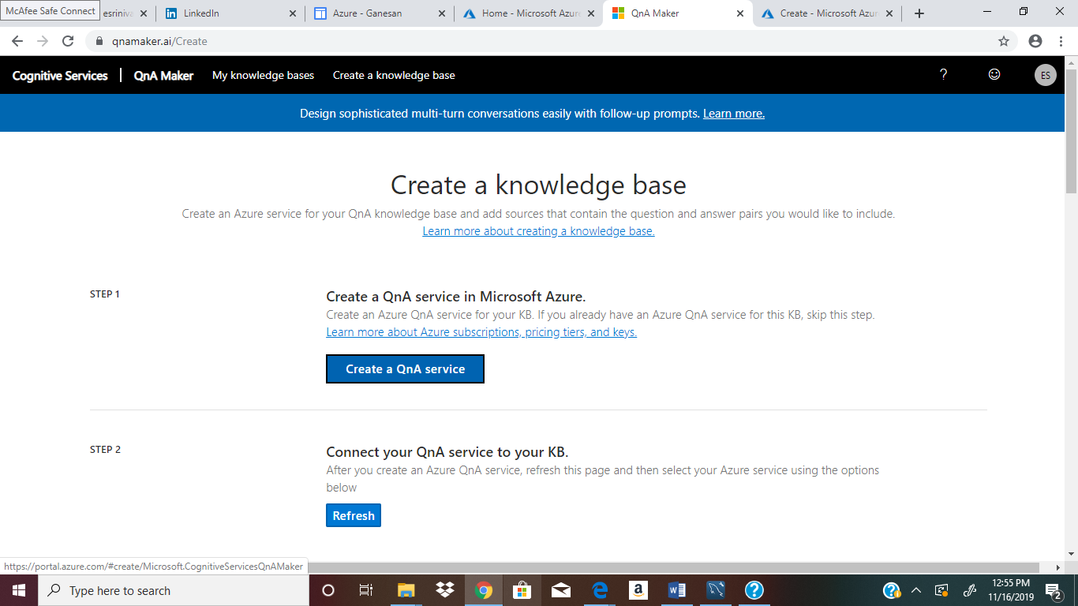
Q n A

Slide 17
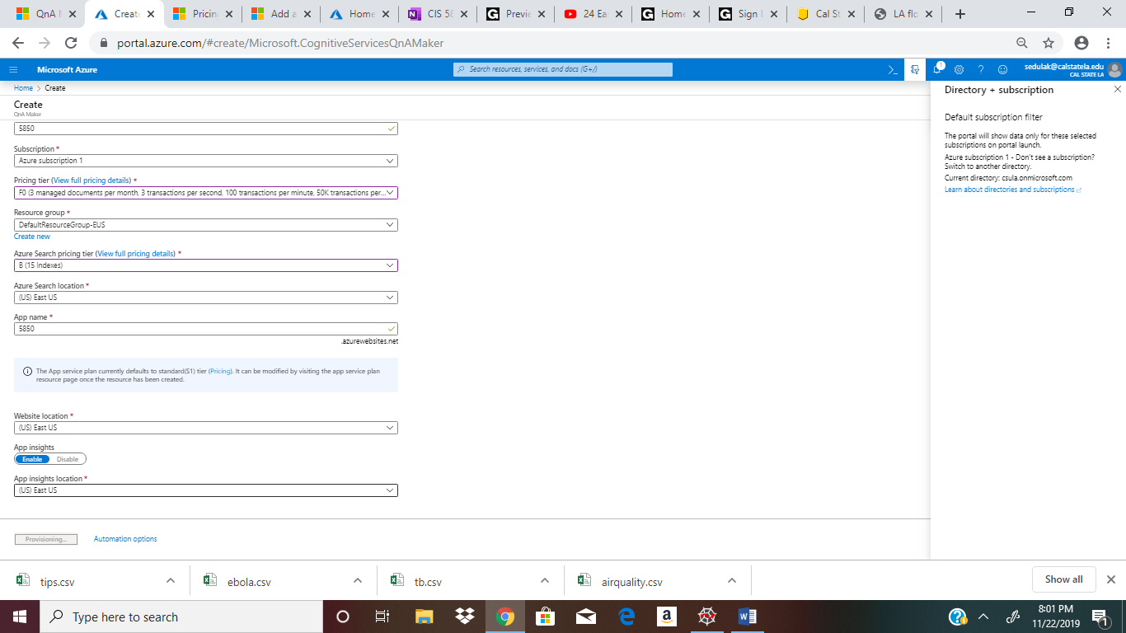
QnA

Slide 18
Deploy Chat Bot
Build my Bot using the name given to my QnA
Enter the area in which you wanted it to be placed
Make the basic bot
Click on create
Bot will be deployed
Test the Bot

Slide 19
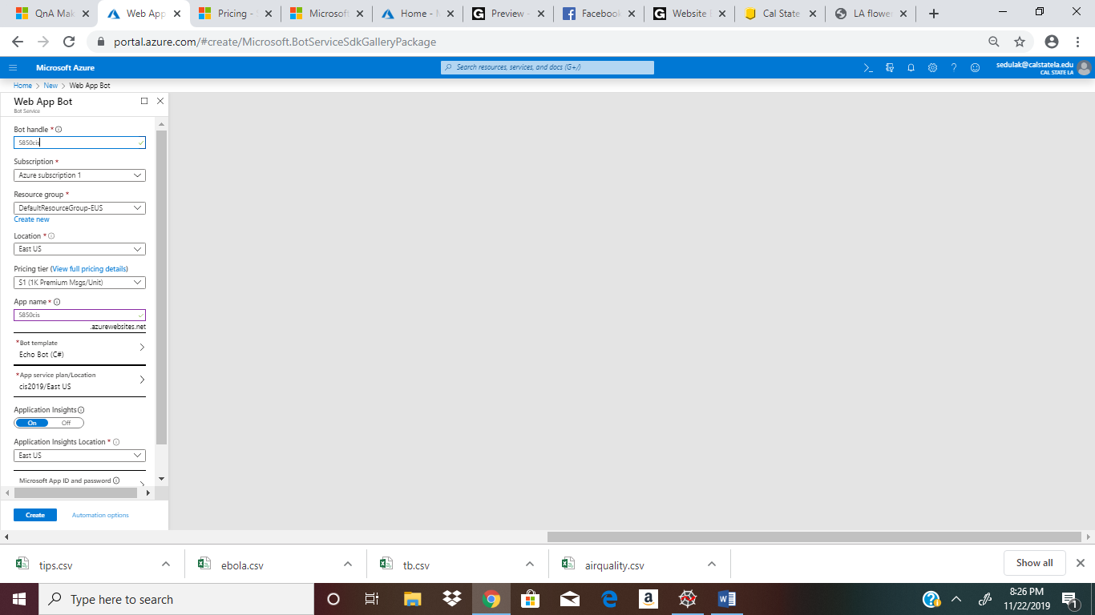
Creating Chat bot

Slide 20
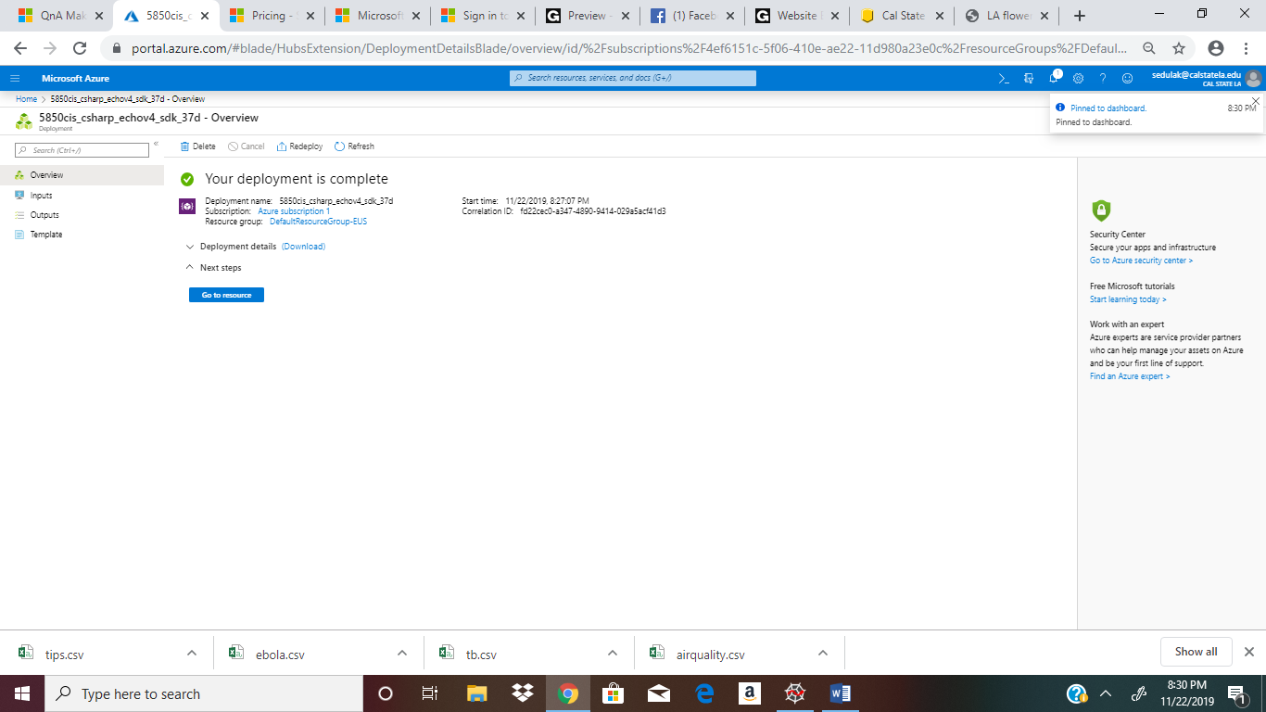
Deployment of chatBot

Slide 21
Integrate Bot to Facebook messenger
Once the Bot is ready, integrate bot to facebook messenger
Enter important information to connect bot like facebook page ID, App ID etc
Call back urls would be generated

Slide 22
Facebook
Create a Facebook page
Get necessary set up of Facebook messenger on developer page
Make the necessary Subcription to messaging options, messaging deliveries , message reads.

Slide 23
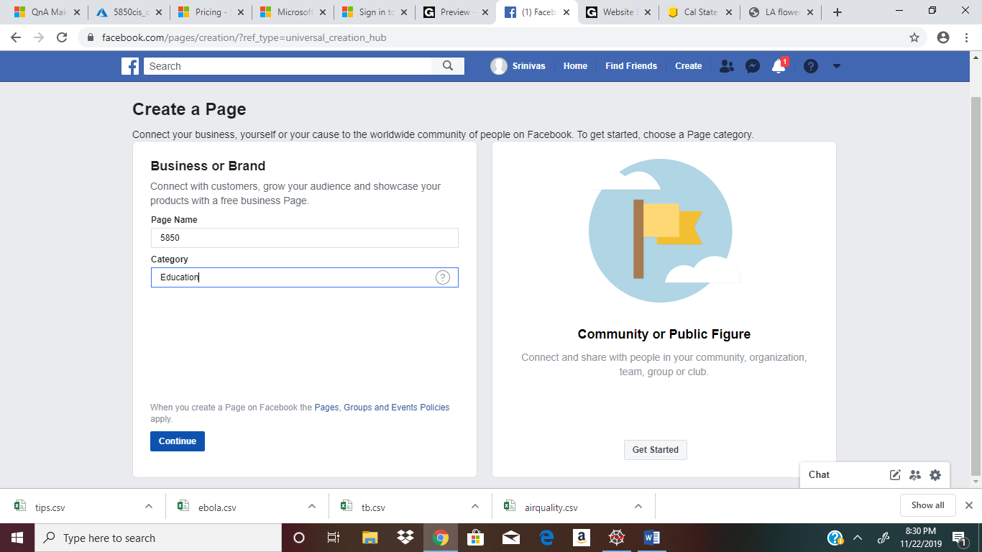
Facebook page

Slide 24
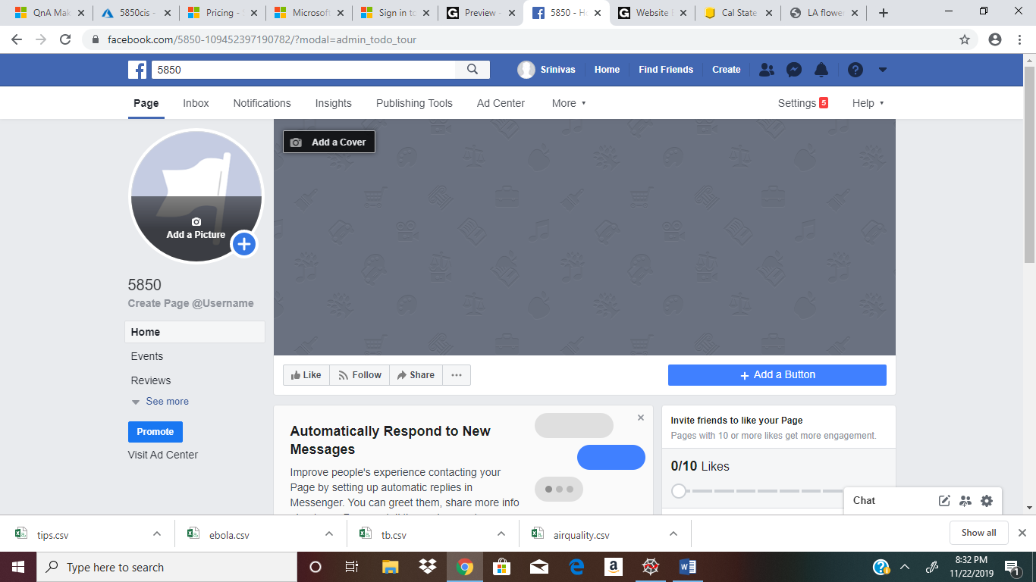
Facebook page

Slide 25
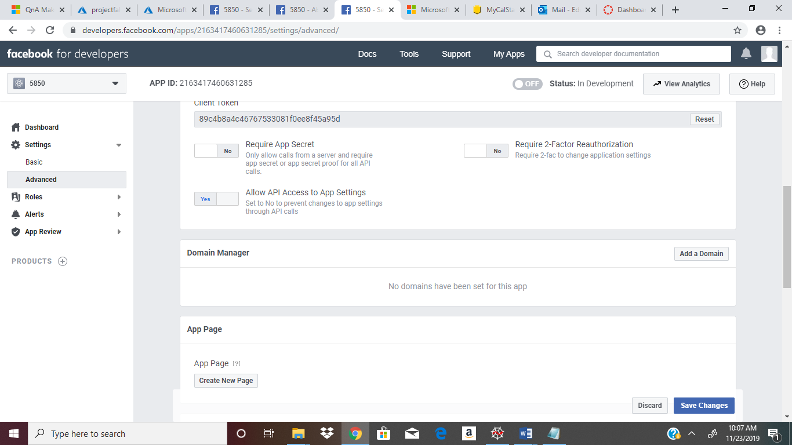

Slide 26
Go back to Azure portal
Save the page
Test whether bot is responding to the messages
Once the Bot is responding
All set to use

Slide 27
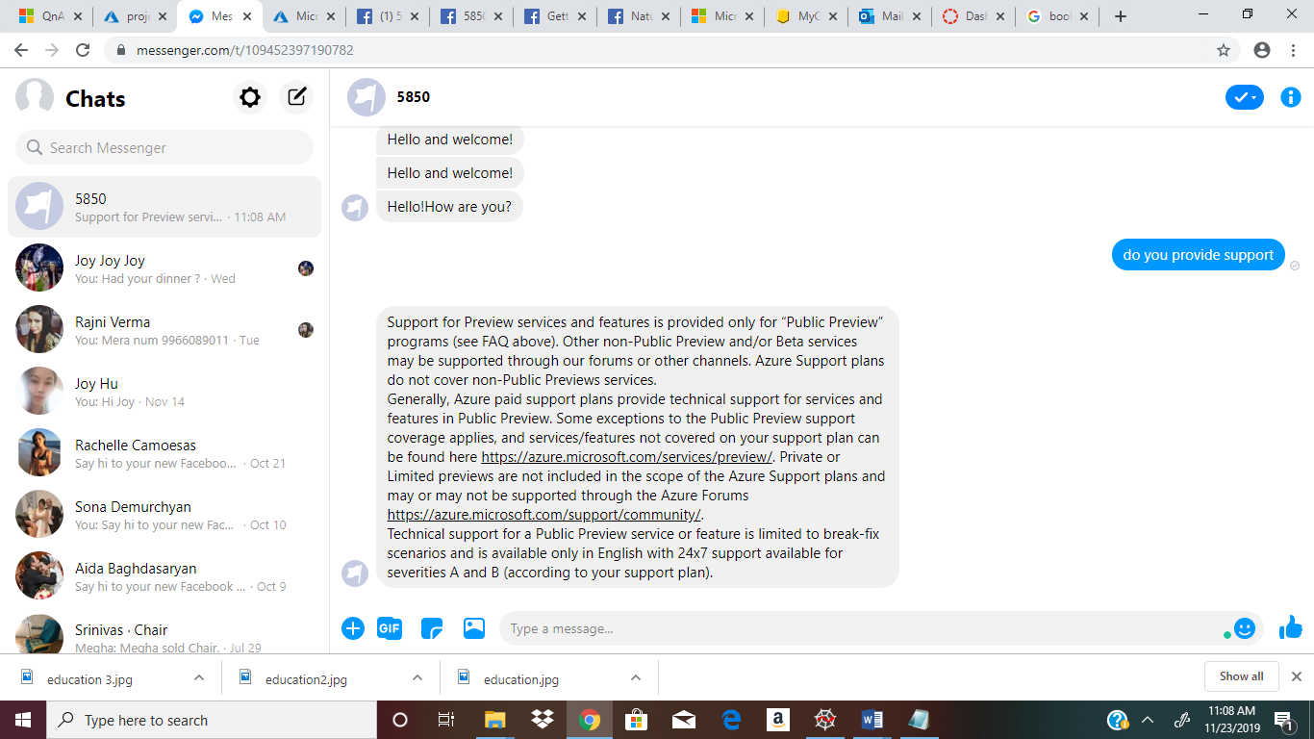
Testing Bot

Slide 28
Discussion
One of the interesting science behind the development of Bots and also the excitement to understand the program functionality has motivated us to take up the project. Though making a chatbot was never an easy task.
It is challenging and always fun to make chatbot and it is possible only because of Azure portal.
Chatbots are used in business applications very prominently from the last 3 years and the skill set to build them are important for every information systems student to learn.

Slide 29
Conclusion
Azure portal made it easy for developers to create things.
Facebook has opened up its messenger platform to let chatbots in to the app
Businesses capitalize in deploying bots ex: Wall street journal uses it to give live stock updates , HP created bot for facebook messenger to print photos , documents.

Slide 30
Web references
https://blog.hubspot.com/marketing/facebook-bots-guide
https://www.oracle.com/solutions/chatbots/what-is-a-chatbot/
https://searchenterpriseai.techtarget.com/definition/AI-Artificial-Intelligence
https://docs.microsoft.com/en-in/azure/bot-service/abs-quickstart?view=azure-bot-service-4.0

Slide 31
https://docs.microsoft.com/en-us/azure/bot-service/bot-service-channel-connect-facebook?view=azure-bot-service-4.0
https://www.forbes.com/sites/forbesagencycouncil/2018/06/04/using-facebook-messenger-and-chatbots-to-grow-your-audience/#2709098a733b

Slide 32
Glossary
Q n A(Question and Answer)
ML(Machine learning)
AI(Artificial intelligence)
NLP(Natural Language processing)
VA(Virtual Assistant)

Slide 33
Question and Answer
☺
Thank you

